Slide 1
Autonomous Vehicles
From Stanley to Shelly and Carla
A Journey in Self-Driving Robots & Cars
Chris Ameter
21 March 2019

Slide 2
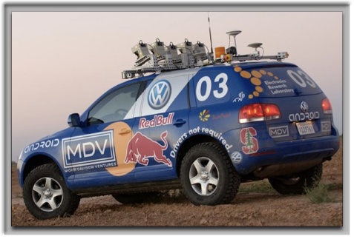


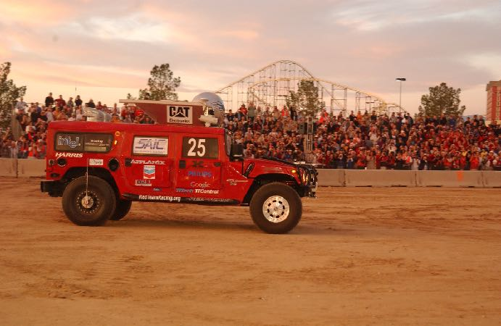

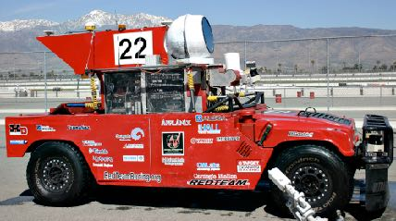
DARPA Grand Challenge
2004 - Top vehicle completed 7.31 of 150 miles.
2005 - Five vehicles completed entire 132 miles.

Slide 3

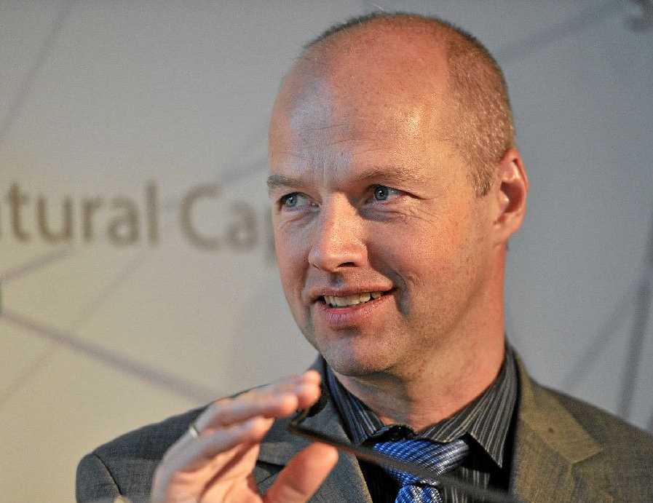

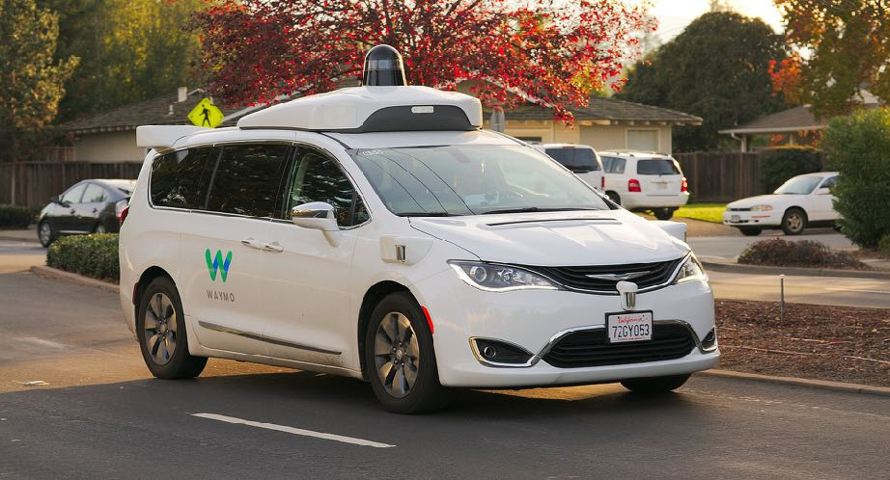
Google
2009 - Began at Google X Lab, led by Sebastian Thrun.
2015 - First fully driverless car ride on public roads.
2016 - Waymo created.
2017 - Began testing autonomous minivans without a safety driver.

Slide 4
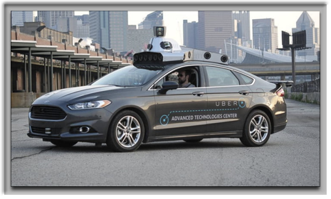
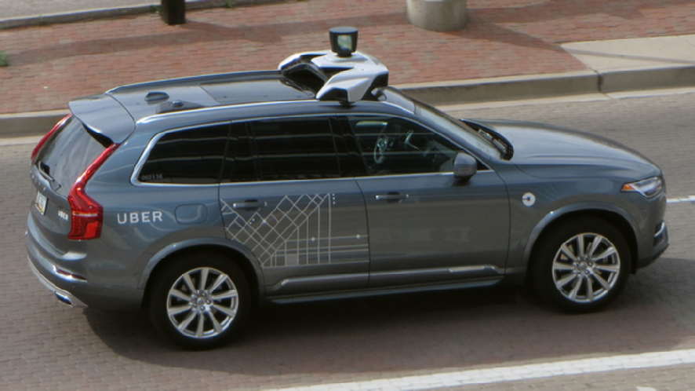
Uber
2015 - Created Advanced Technologies Group near Carnegie Mellon.
2016 - Purchased Otto for $625 million.
2017 - Began carrying passengers (w/ safety driver).
2018 - First fatal accident.

Slide 5
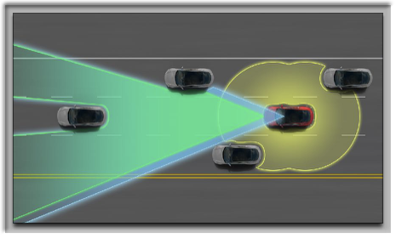
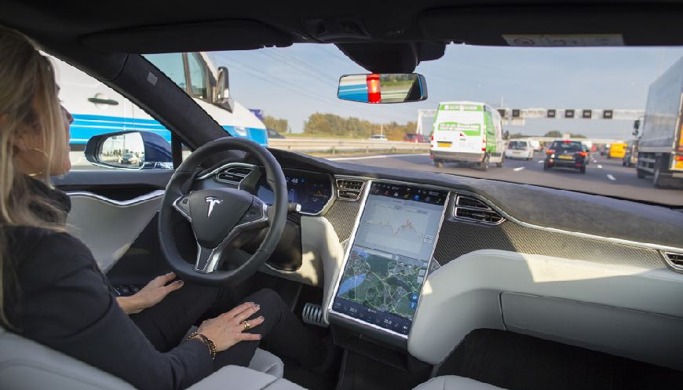
Tesla
2015 - Released “Autopilot” driver-assistance system, developed by Mobileye.
2016 - Announced all future vehicles had the necessary hardware to enable full autonomy.
2017 - Gained semi-autonomous capability, including autosteer.

Slide 6
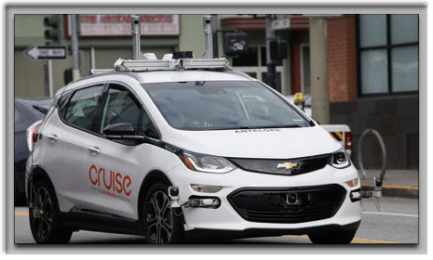
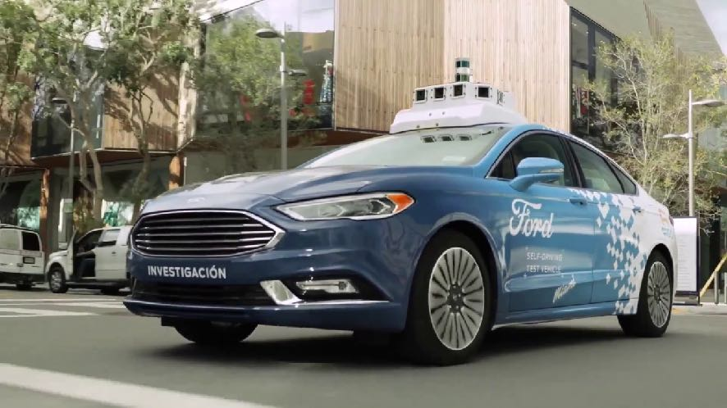
Traditional Automakers
2016 - GM purchased Cruise Automation for $1 billion.
2017 - Ford invested roughly $1 billion in a joint venture with Argo AI.
2019 - BMW & Daimler announce partnership to deliver full self-driving cars by “mid-2020s.”

Slide 7


SAE Automation Levels
Human driver monitors the driving environment
0 No Automation
1 Driver Assistance (“hands on”)
2 Partial Automation (“hands off”)
Automated driving system monitors the driving environment
3 Conditional Automation (“eyes off”)
4 High Automation (“mind off”)
5 Full Automation (“steering wheel optional”)

Slide 8
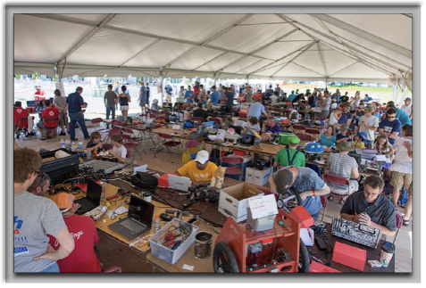
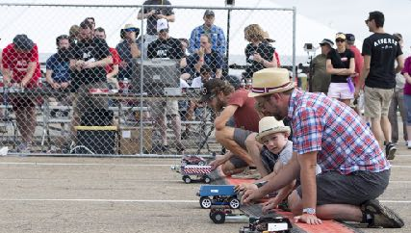
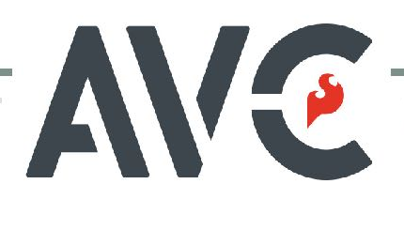
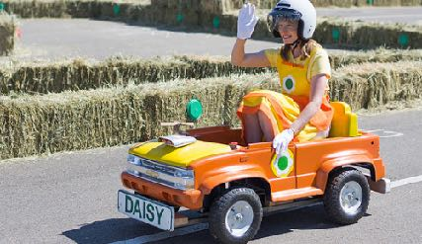
Sparkfun AVC
2009 - 2018
National Robotics Competitions

Slide 9
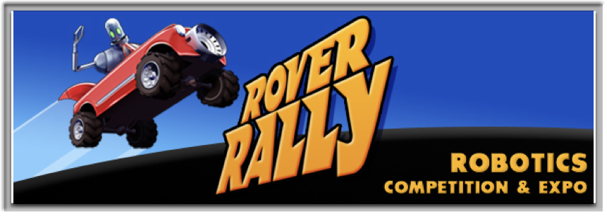

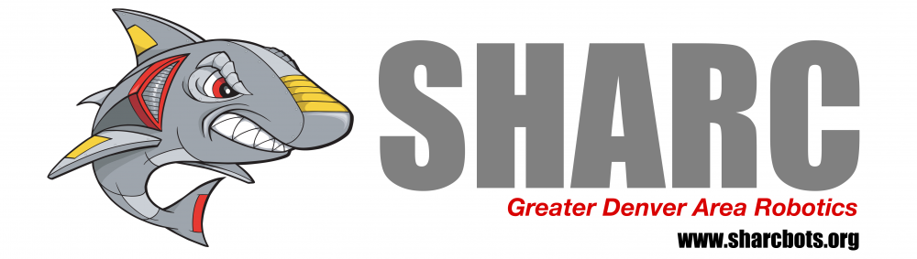
Rover Rally
2015 - 2017
Regional Robotics Competitions

Slide 10

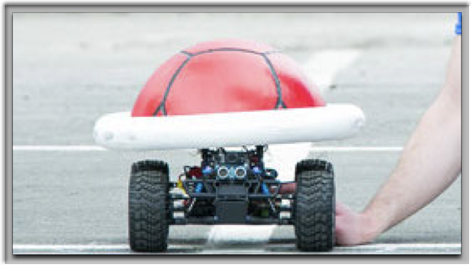
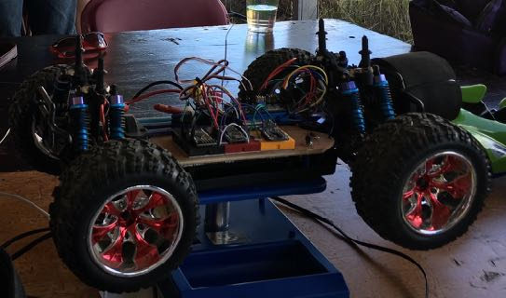

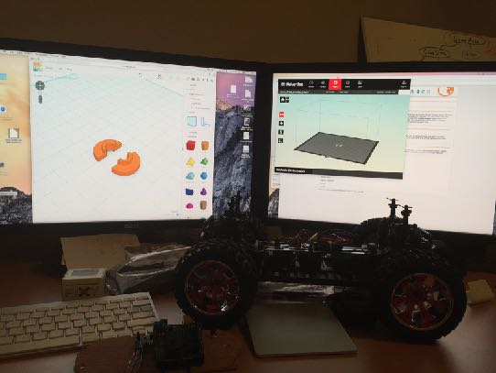


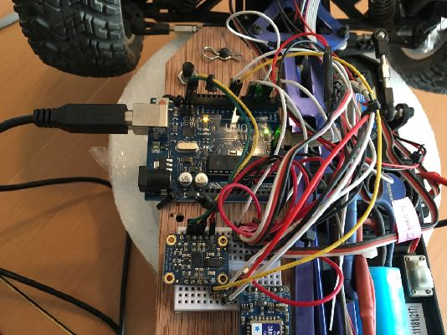
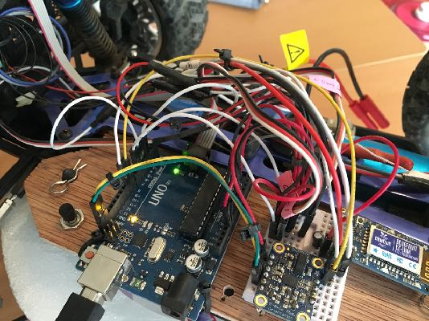
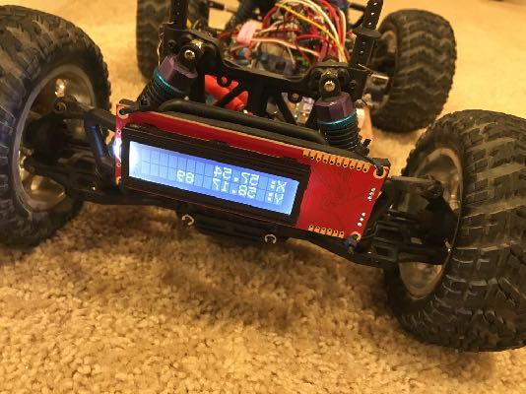
Meet Shelly (Shell Shock)

Slide 11

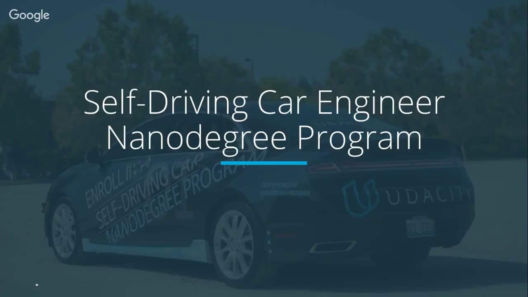
Udacity Self-Driving Car Engineer
“Nanodegree” Program
3 terms (roughly 1 year)
Robotics, Computer vision, deep learning, sensor fusion, control processing

Slide 12
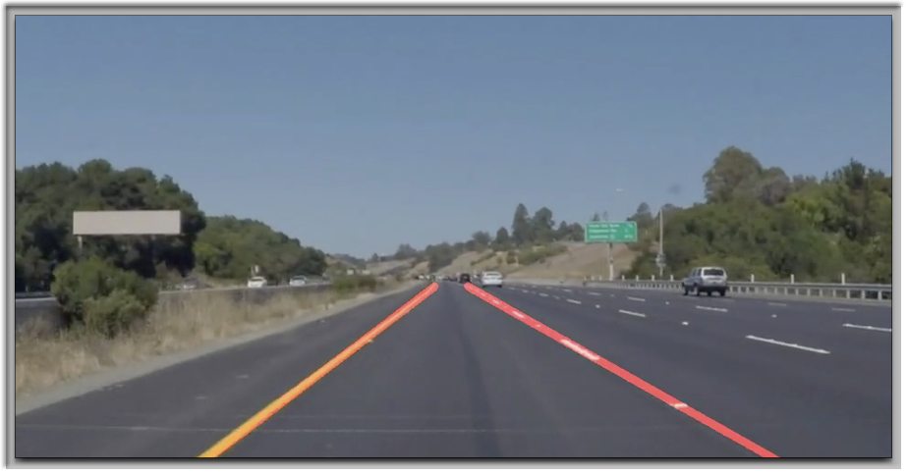
Project: Finding Lane Lines

Slide 13
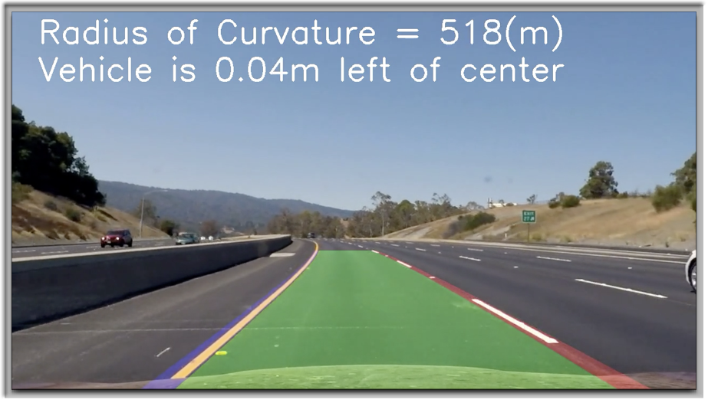
Project: Advanced Lane Finding

Slide 14
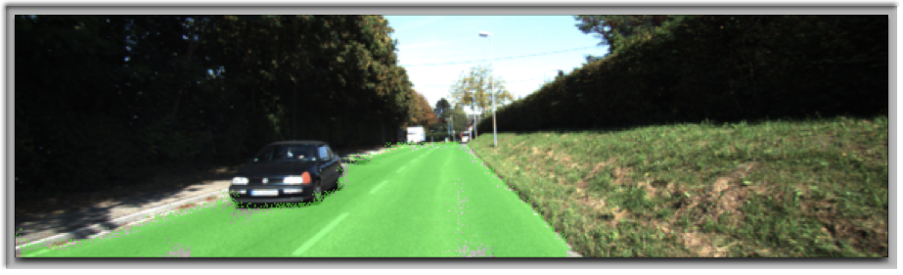

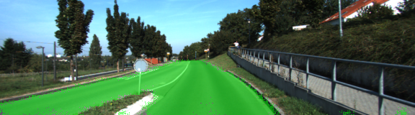
Project: Semantic Segmentation

Slide 15
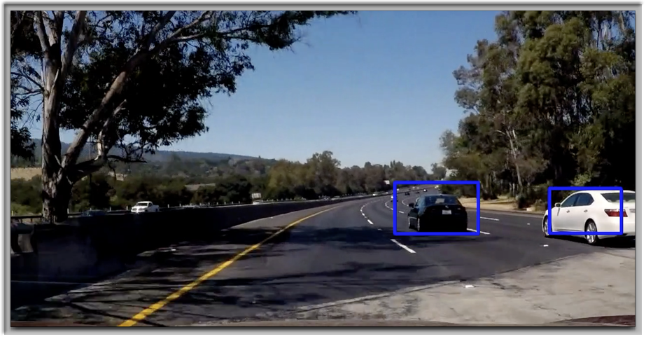
Project: Vehicle Detection

Slide 16
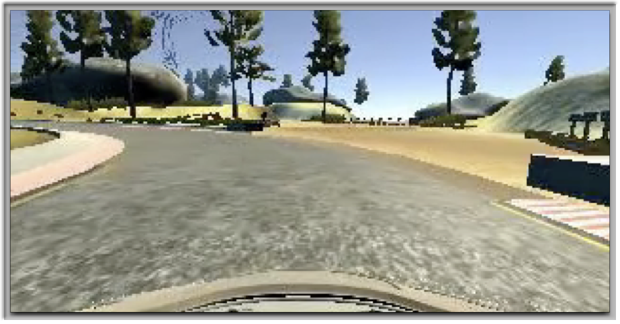
Project: Behavioral Cloning

Slide 17
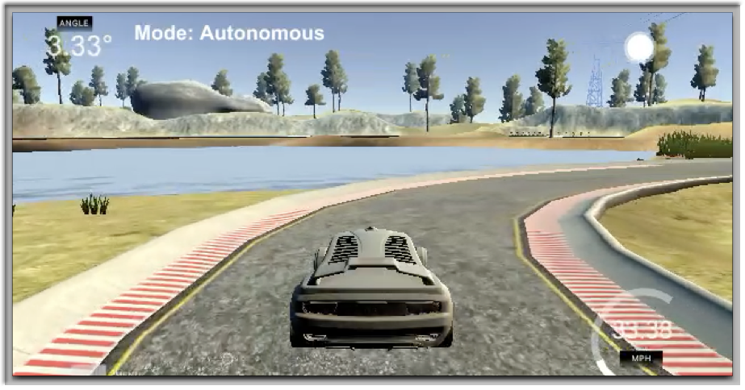
Project: PID Control

Slide 18
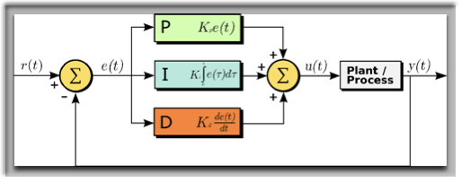
PID Controllers
Control loop feedback mechanism
Applies accurate and responsive correction to a control function
proportional, integral, derivative
Error
amount, time, rate of change
previous_error = 0
integral = 0
loop:
error = setpoint - measured_value
integral = integral + error * dt
derivative = (error - previous_error) / dt
output = Kp * error + Ki * integral + Kd * derivative
previous_error = error
wait(dt)
goto loop

Slide 19
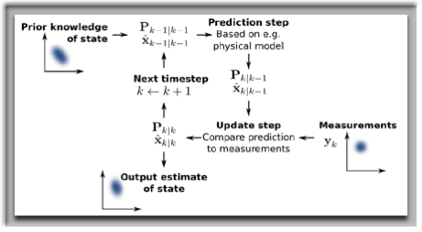
Kalman Filters
Use a series of measurements over time to produce estimates that are more accurate than those based on a single measurement.
2 steps
prediction
update
Extensions
Extended Kalman Filters (EKF)
Unscented Kalman Filters (UKF)

Slide 20
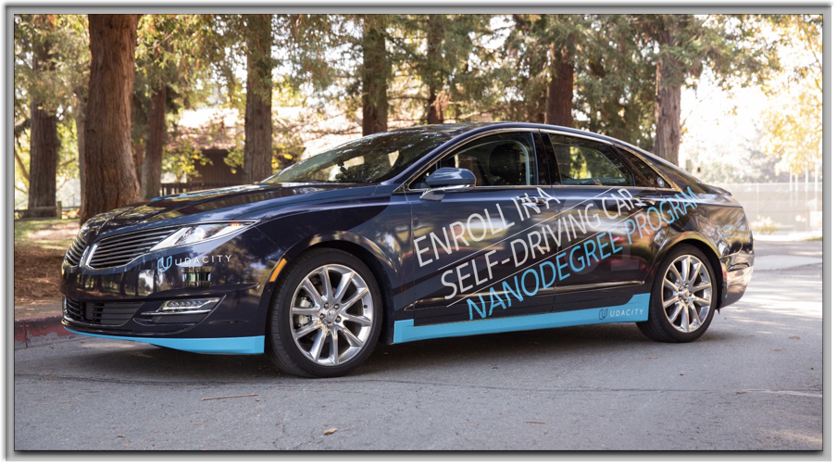
Meet Carla

Slide 21
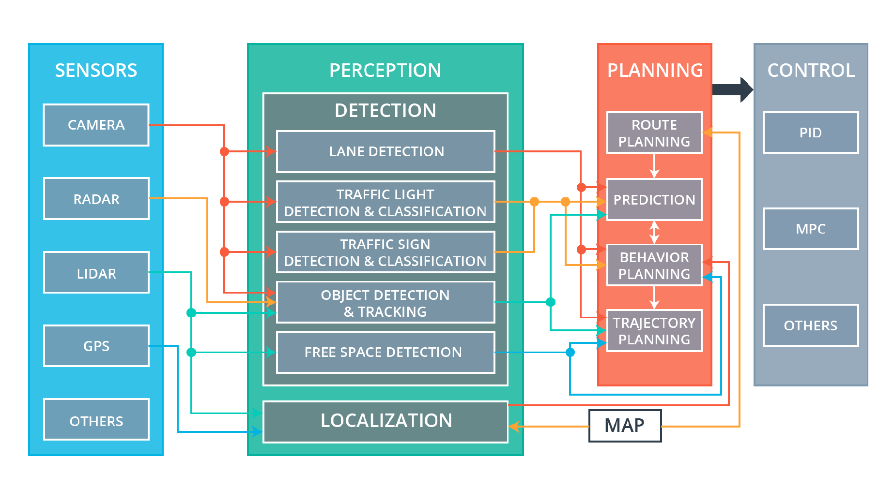
Carla’s Subsystems

Slide 22




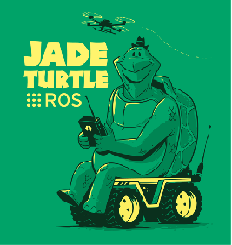




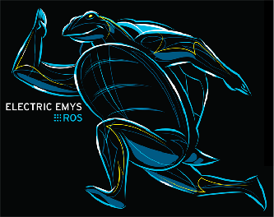
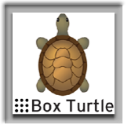

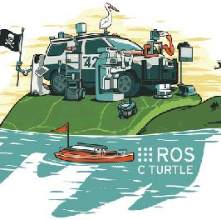
ROS
Released 2007
Language and platform independent tools:
Perception
Decision Making
Actuation
Client libraries
roscpp, rospy, roslisp

Slide 23

Carla Processing Architecture

Slide 24
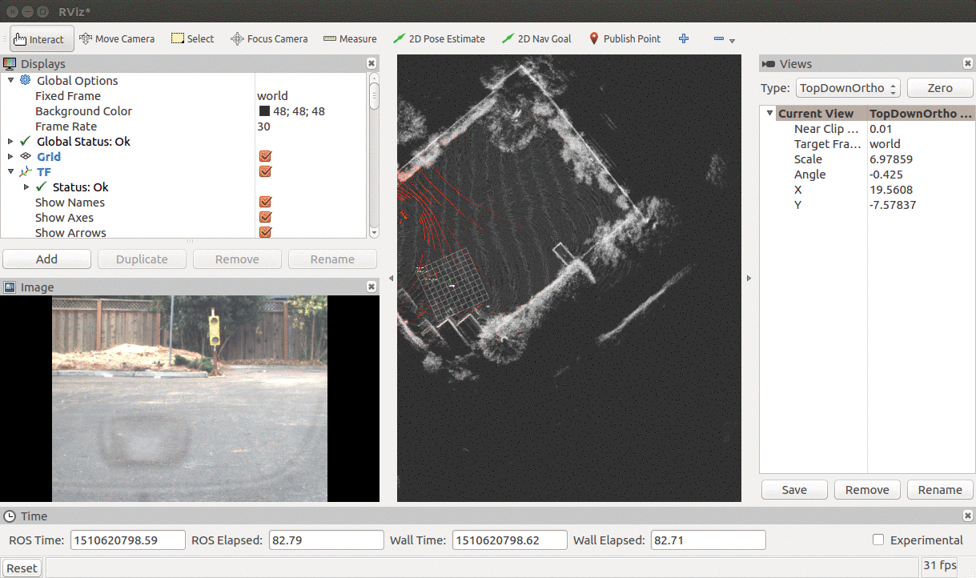
Final Project Output

Slide 25
Winning the DARPA Grand Challenge, Google TechTalks
https://www.youtube.com/watch?v=TDqzyd7fDRc
DARPA Grand Challenge (2004-5) driverless car competition (NOVA - The Great Robot Race)
https://www.youtube.com/watch?v=ihXE1Iu5E3o

Slide 26

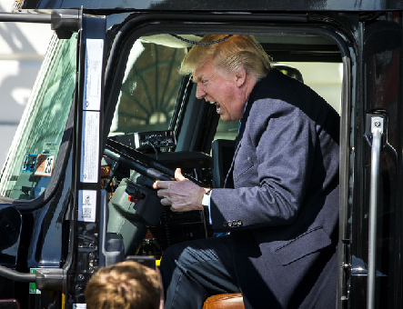
“Can you imagine, you're sitting in the back seat and all of a sudden this car is zig-zagging around the corner and you can't stop the f—-ing thing?”
“Self-driving cars will never work.”
“I would never get in a self-driving car. ... I don't trust some computer to drive me around.”
–Donald Trump

